Slide 1
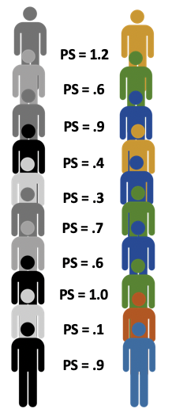
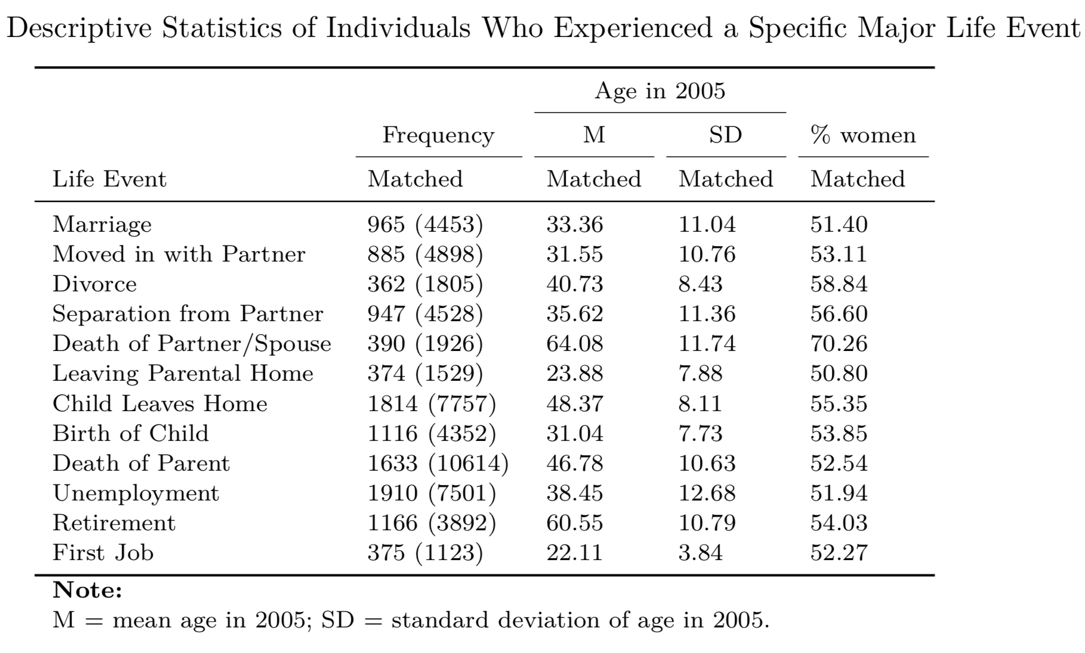

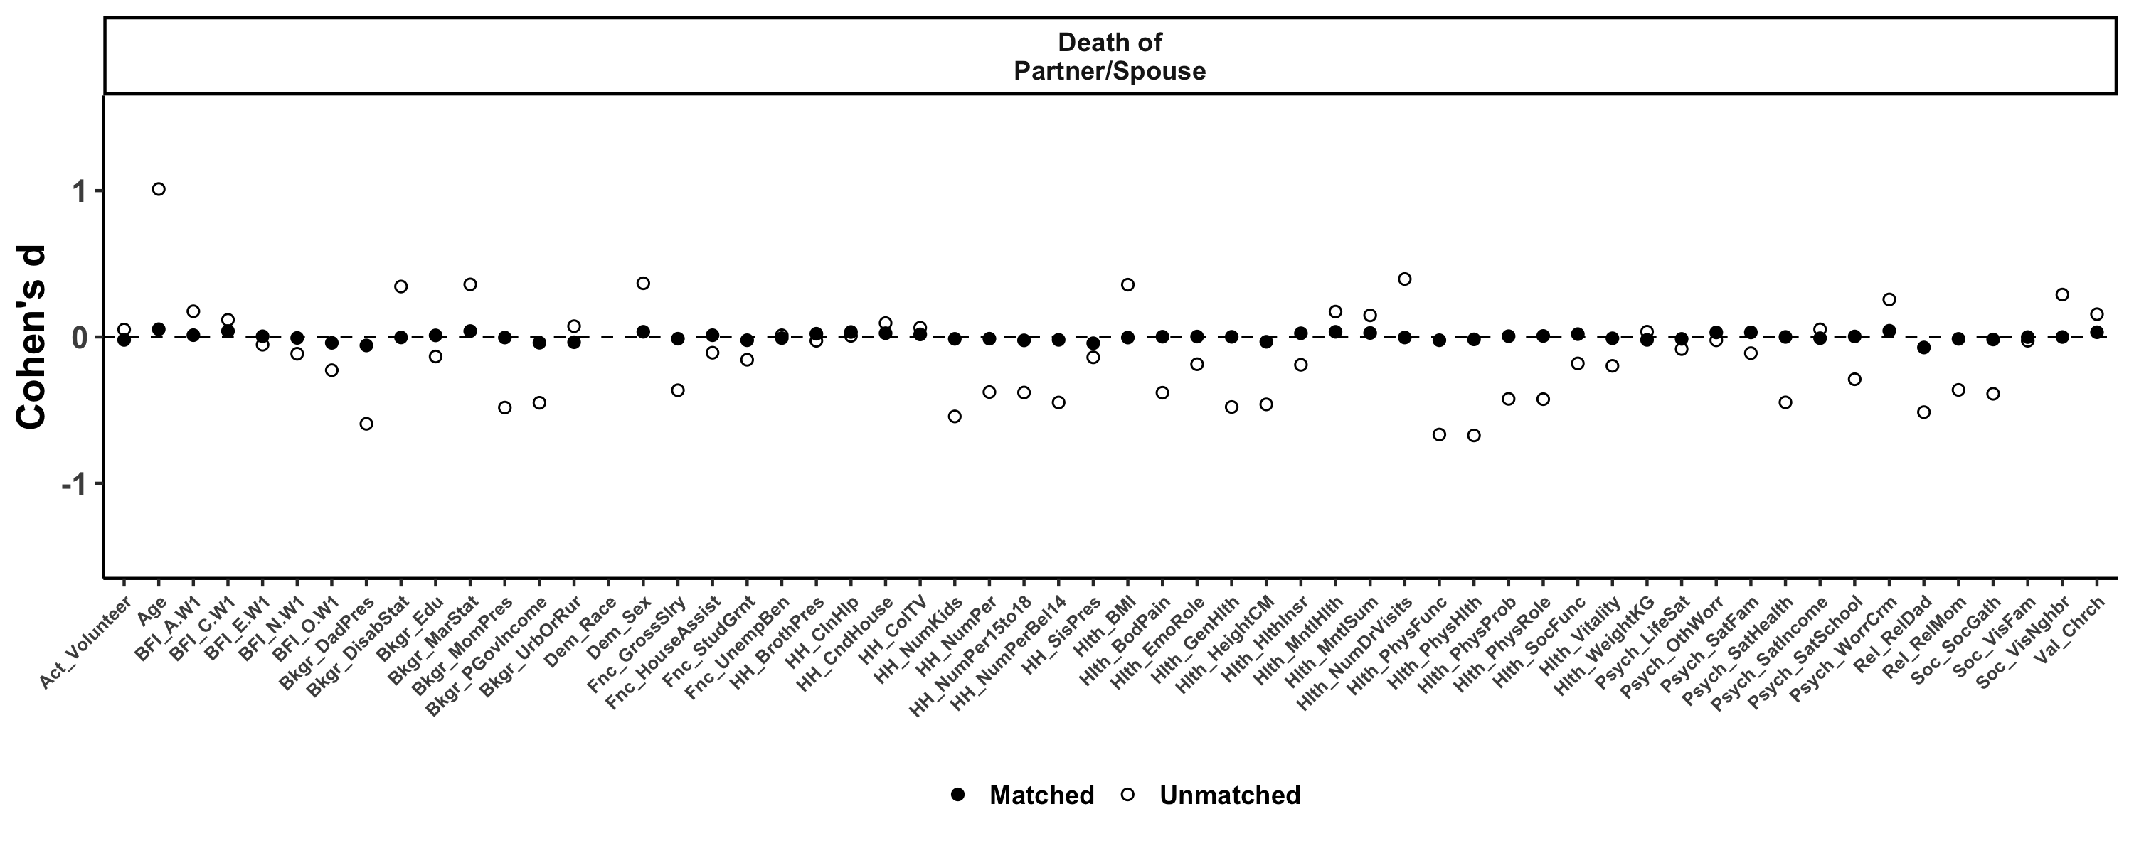
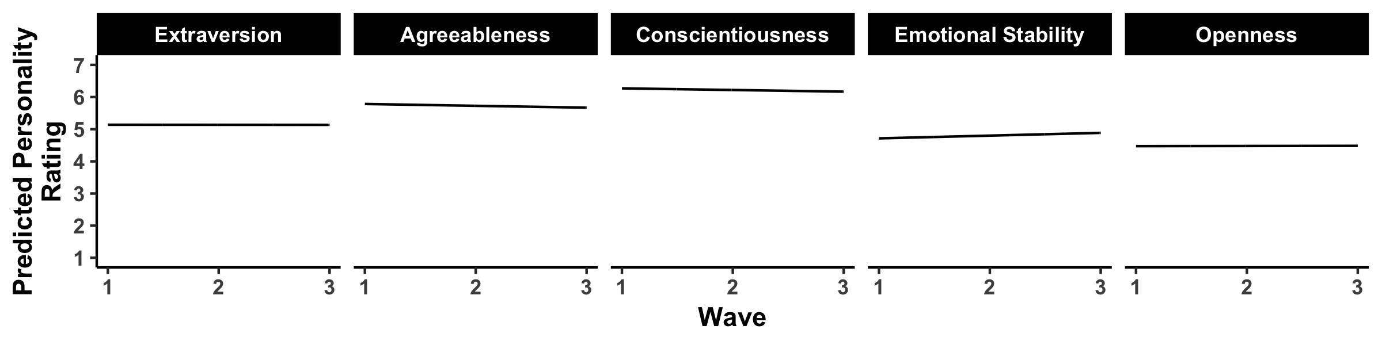
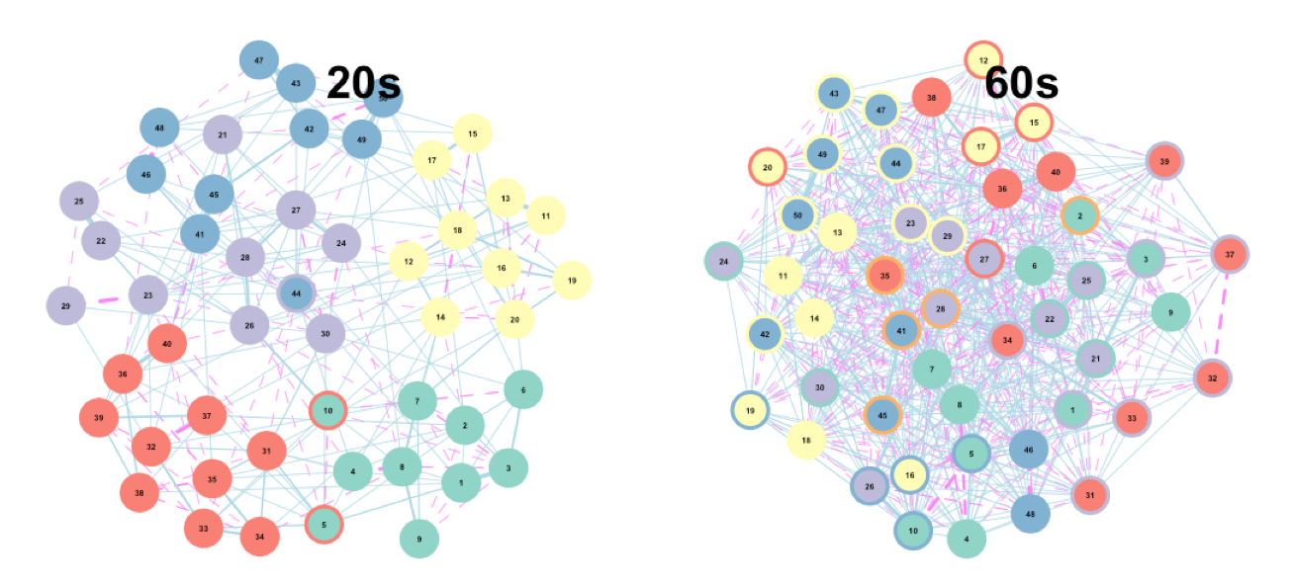
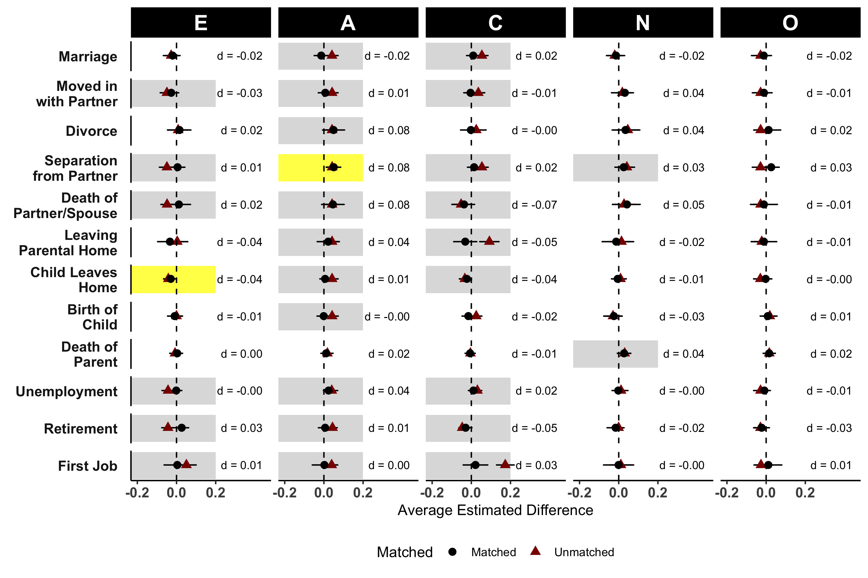
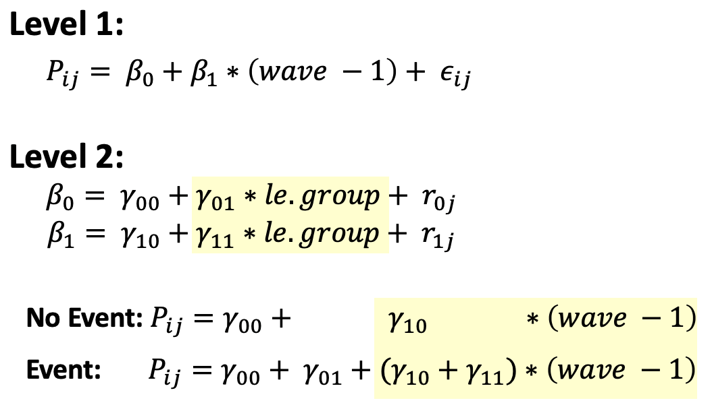
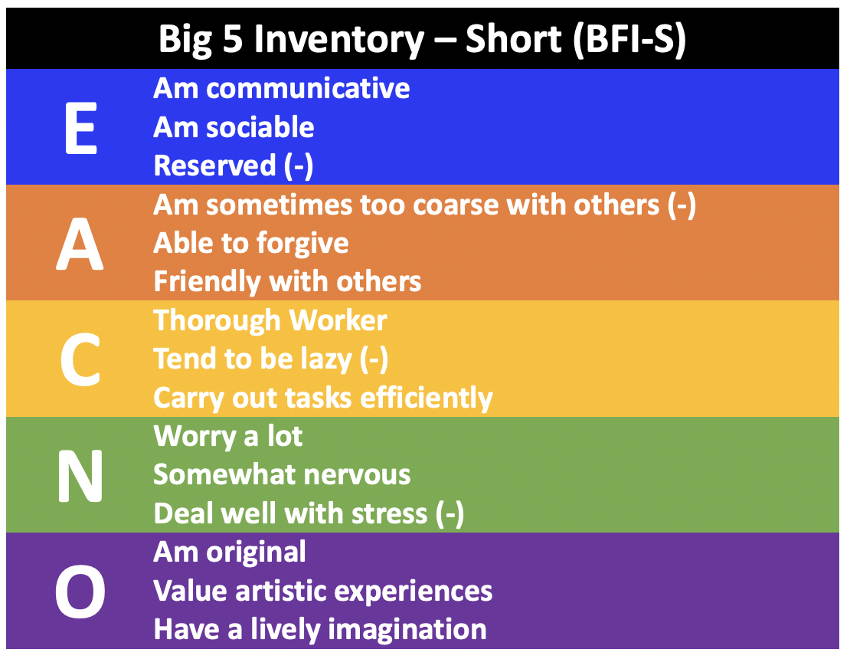
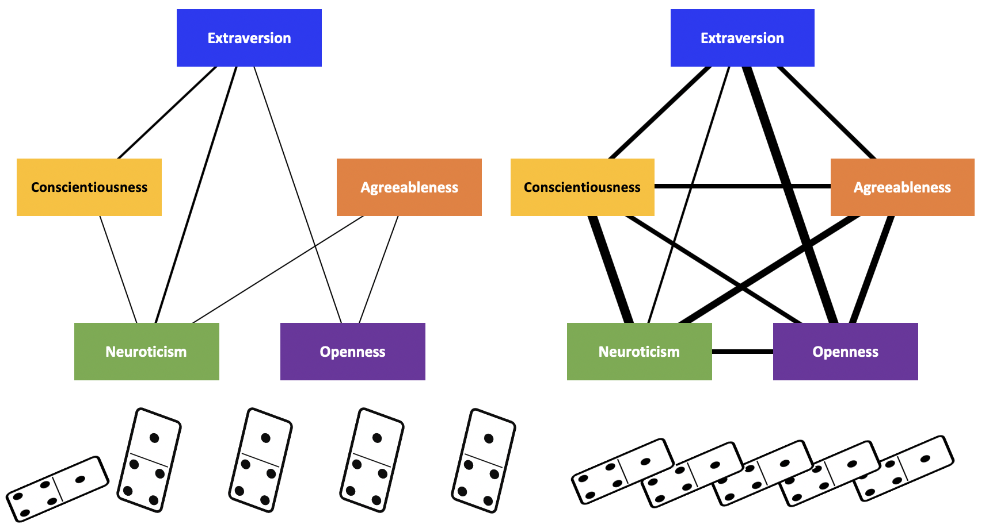
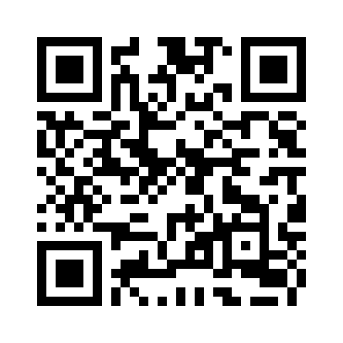
Do Major Life Events Change Personality?
A Propensity Score Matching Approach
Emorie D Beck
Washington University in St. Louis
Joshua J Jackson
Washington University in St. Louis
Introduction
Propensity Score Matching
Conclusions
Longitudinal Personality Change
No Event
Event
Little evidence of socialization effects, when controlling for selection bias
That is, selection bias may account for inconsistent evidence of socialization effects of life events on personality, highlighting the need for better measurement and modeling of personality and time
The Big 5
Extraversion
Agreeableness
Conscientiousness
Neuroticism
Openness
Direction
Magnitude
--
.6 SD
1 SD
-.8 SD
.4 SD
Timing
--
Lifespan
Lifespan
10-35
10-20
Socialization Effects
Marriage / Move in with Partner (-)
(Specht et al., 2011)
Changing Majors (+)
(Lüdtke et al., 2011)
Retirement (-)
(Specht et al., 2011)
Psychotherapy (-)
(Lüdtke et al., 2011;
Roberts et al., 2017)
Retirement (+)
(Schwaba & Bleidorn, 2017)
Leave Parents’ Home (-)
(Specht et al., 2011)
Separate from Partner (+)
(Specht et al., 2011)
Child Birth (-)
(Specht et al, 2011)
First Job (+)
(Lüdtke et al., 2011)
Child Birth (+; Men only)
(van Scheppingen et al, 2016)
Future Directions
Romantic Relationships (+)
(Neyer & Lehnart, 2007)
Military Service (-)
(Jackson et al., 2012)
First Job (+)
(George, Helson, & John, 2011; Lüdtke et al., 2011; Specht et al., 2011)
Romantic Relationships (-)
(Neyer & Lehnart, 2007)
Marriage (-)
(Specht et al., 2011)
Alternative Explanations of Change
Selection
Socialization
Limitations
Nonlinear Change
(e.g. Schwaba & Bleidorn, 2018)
Conscientiousness
Conscientiousness
Selection Bias
Work Experiences
Work Experiences
Socialization Effects
Barrick, Mount, & Judge, 2001
Roberts, Caspi, & Moffitt, 2003
Mean-Level Change
Do life events change personality when controlling for selection bias?
Method
Structural Change
(Beck, Condon, & Jackson, 2019; Jackson & Beck, 2019)
German Socioeconomic Panel Study (GSOEP)
Group Differences in Matched and Unmatched Change
Life Events
1984
2005
2009
2013
Personality
Idiographic Change
(van Leemput et al., 2014; Beck & Jackson, 2019ab; Cramer et al., 2016)
Close to Transition
Poster, Data, & Code
Far from Transition
Preregistration: https://osf.io/vdazq/

